Slide 1
BirD SPECIES OBSERVATION ANALYSIS
Name : Challa HARIKA
Tools Used : power BI, EXCEL

Slide 2
Project Explanation
I analyzed bird observation data across forest and grassland habitats to study temporal, spatial, species, environmental, distance and behavior, Observer Trends, Conservation Trends and species-level patterns.
Business Problem
I helped organizations understand biodiversity distribution and identify conservation priorities.
Key Insights
Identified seasonal and time-based bird activity trends
Discovered biodiversity hotspots across locations
Analyzed environmental impact on bird behavior
Detected rare and at-risk species for conservation focus
Business Impact
This project supports wildlife conservation, land management, Eco-Tourism, Sustainable Agriculture, Policy Support, and Biodiversity Monitoring.

Slide 3
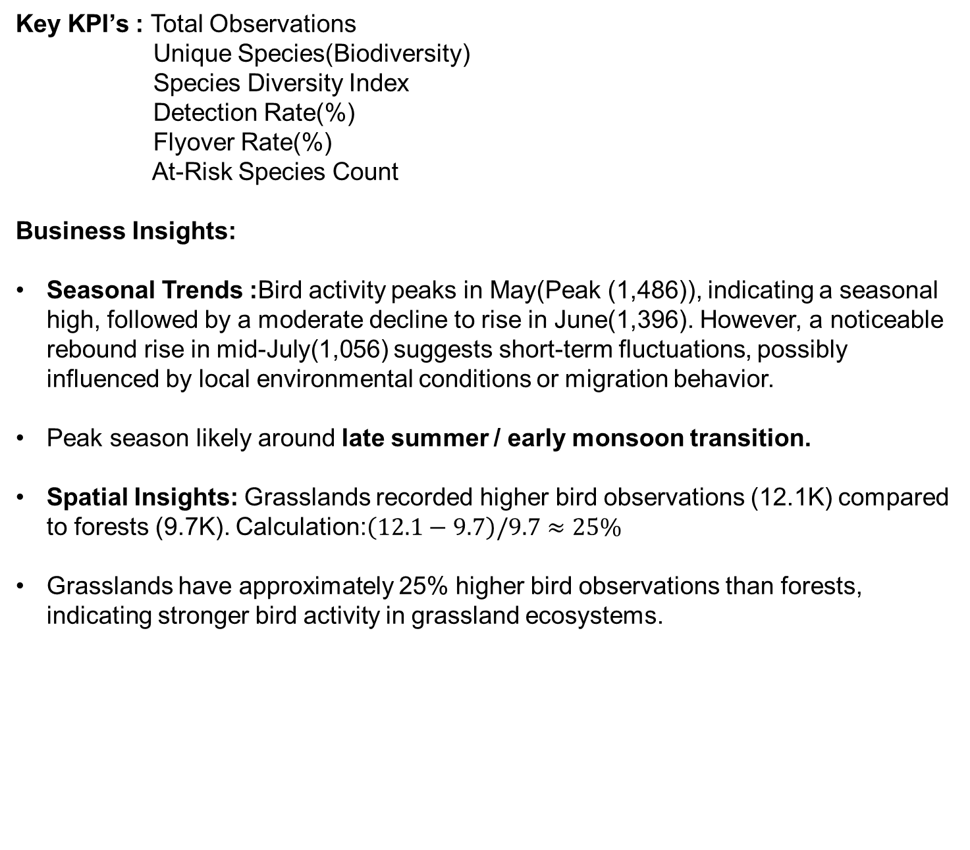
Key KPI’s : Total Observations
Unique Species(Biodiversity)
Species Diversity Index
Detection Rate(%)
Flyover Rate(%)
At-Risk Species Count
Business Insights:
Seasonal Trends :Bird activity peaks in May(Peak (1,486)), indicating a seasonal high, followed by a moderate decline to rise in June(1,396). However, a noticeable rebound rise in mid-July(1,056) suggests short-term fluctuations, possibly influenced by local environmental conditions or migration behavior.
Peak season likely around late summer / early monsoon transition.
Spatial Insights: Grasslands recorded higher bird observations (12.1K) compared to forests (9.7K). Calculation:$\left(12.1−9.7\right)/9.7≈25\%$
Grasslands have approximately 25% higher bird observations than forests, indicating stronger bird activity in grassland ecosystems.

Slide 4
Species Insights:
Top Species Insights: The top observed species are Vireo olivaceus (849), Zenaida macroura (606), and Turdus migratorius (573), contributing significantly to overall observations, indicating dominance of a few species in the ecosystem.
Rare Species Insights: Rare species such as Aix sponsa (5) and Accipiter cooperii (3) have very low observation counts, indicating limited presence or potential conservation concern.
Plot-level Insight: Plot ROCR-0172 recorded the highest species diversity with 17 species (13.49%), making it a key biodiversity hotspot.
Environmental Insights:
Bird observations are highest under moderate environmental conditions—specifically temperatures between 21°C and 25°C and humidity between 79% and 88%. Additionally, most birds are observed within 50-100 meters, indicating higher activity or visibility in stable weather conditions such as partly cloudy skies.
Distance & Behavior:
Bird observations are primarily concentrated within 0–100 meters, indicating localized activity. Additionally, Flyover activity is significantly higher in grasslands (1724) compared to forests (101), indicating substantially greater bird movement in open habitats. Grasslands show over 15x higher flyover activity than forests, highlighting strong habitat-driven differences in bird movement behavior.

Slide 5
Observer Insights : Elizabeth Oswald recorded the highest number of observations (301), followed by Kimberly Serno (249), indicating a noticeable variation in observation contribution across individuals.
Conservation Insights: The analysis identified 8 at-risk species (6% of total), with several species flagged under both national and regional conservation programs. These species are distributed across forest and grassland habitats, with forests showing slightly higher concentration. Low observation counts indicate rarity, emphasizing the need for targeted conservation and monitoring efforts.”
Summary : Bird activity is highest in grasslands under moderate environmental conditions, with most observations occurring within short-to-moderate distances. While a few species dominate the dataset, several at-risk species primarily in forest habitats highlight the need for targeted conservation and balanced data collection.

